Slide 1
Advanced Software Construction
Day 0

Slide 2
Touchdown!
This is the 4th semester elective course Advanced Software Construction (ASWC)
I am Per Laursen, and I will be teaching this course
It is Wednesday, January 30th@ 0900; this is the time the course starts every Wednesday (except Week 10)
The website for the course is here:
http://perl-easj.dk/ASWC4SemDatF19.html
The language for the course is English

Slide 3

Touchdown!
I am Per Laursen, and I will be teaching this course
Website: perl-easj.dk
GitHub: github.com/perl-easj
Sorry, I’m not changing from EASJ to Zealand right now…

Slide 4
Touchdown!
Bio (short ☺)
1967: Born
1994: Ph.D. Computer Science
1995-2008: Software Developer private sector
2008-now: Teacher Zealand (Z3414nd…)
See (a bit) more on perl-easj.dk/about.html

Slide 5
Touchdown!
You are:
Students who have chosen this course voluntarily
Have a genuine interest in Software Design/Construction (Design: Object-Oriented Design)
Are comfortable with programming in C# using Visual Studio 2017+ with ReSharper
Want to participate in discussions about design/code
Willing to create and expose own design/code
Self-driven, self-motivated, etc..

Slide 6
1-2-3
Outline for today
Class #1 (now): Outline of course
Class #2 + #3 (rest of morning): Brush-up on key elements in OO-Programming, using C# + Visual Studio
Class #4-#6 (afternoon): Warm-up exercise:
Presentation of exercise (me)
Work on exercise in small groups (you)
Discussion of solutions (me + you)
Breaks: Lunch (11.30-12.15), otherwise as fits

Slide 7
WHY…?

Slide 8
Why do you need an ASWC course?
My opinions on SWC first year:
Mostly about learning the basics of design/programming
Just learning the basics is hard enough!
Projects: Much effort spent on implementing CRUD in a UWP app based on MVVM architecture
Projects: Usually not so much focus on business logic 😐
Only few students achieve a level of SWC maturity where you can truly reflect over design/code choices

Slide 9
Why do you need an ASWC course?
My opinions on our ”product” (i.e. you):
You should be able to ”hit the ground running” in an organisation which develops software!
Modern software is complex – we need ways to manage design/code complexity
Important competences:
Awareness of the SOLID principles
Operational knowledge on common, useful Design Patterns
Ability to form a (sensible) opinion about Design/Code choices
Ability to use tools/techniques to improve Design/Code quality

Slide 10
Skill gap in ”fundamental” SWD/SWC diciplines
What the World expects…
?
After 1. + 2. (+3.) semesters

Slide 11
Why do you need an ASWC course?
Tools/technology vs. skills
What is best:
Knowing about contemporary tools and technologies
Knowing about sort-of-timeless, tech-neutral best practices for design/code
No clear-cut answer…
Why not both? Sure, so see this course as belonging (mostly) to the latter category

Slide 12
Quality

Slide 13
What is high-Quality Design/Code?
“it depends…”

Slide 14


Slide 15


Slide 16



Slide 17


Slide 18
What is Quality? “words ending with …bility”

Slide 19
Usability Reliability Extensibility Reusability Maintainability Portability …bility

Slide 20
First-to-market-ability Proof-of-concept-ability …bility
Usability Reliability Extensibility Reusability Maintainability Portability …bility

Slide 21
Quality is scenario-specific, but…!
You can always challenge assumptions about quality
In this course, we assume that:
Quality = Intrinsic Quality of Design/Code
Quality measures are not influenced by external factors like time-to-market
Code will be maintained and extended over time
No business-case needed for improving quality
Be aware that this is not always true in the Real World

Slide 22
How do we implement High Quality in Design/Code?

Slide 23
Best Practices for OO Design/Code
Again, many opinions about this…
Approaches that have survived the test-of-time
SOLID Principles
Design Patterns
Refactoring (towards Design Patterns)

Slide 24
Best Practices for OO Design/Code
Design Patterns, Refactoring and SOLID Principles help us create high-quality designs/code
We will (in this course) implement these in C#
You know C#... but probably not all of C# ☺
We will look into several more-or-less advanced C# language constructions as well
Other OO-languages will probably also contain these features in some form

Slide 25
What are the SOLID principles?

Slide 26
Single responsibility Open/Closed Liskov Substitution Interface Segregation Dedendency Injection

Slide 27
What are the SOLID principles?
Also a distilled version of Best-Practices
More general than Design Patterns – do not solve one specific problem
Many Design Patterns are “instances” of following the SOLID principles.

Slide 28
Single Responsibility
Classes should only have one main responsibility
=> classes should only have one reason to change
Keep classes small, focused and abstract

Slide 29
Open/Closed
Software entities should be open for extension, but closed for modification.
Open for extension: behavior can be extended with new behaviors
Closed for modification: Extension does not require change in the source code for the entity

Slide 30
Liskov Substitution
Principle relating to how to create inheritance hierarchies
Ensures that a client can create and use sub-classes of provided classes without changing the expected behavior
Inheritance should not break the original code…

Slide 31
Interface Segregation
Interfaces: abstract definitions of behavior
Clients should ”see” objects through interfaces
Smaller interfaces => less dependency between clients and objects
One object may implement many interfaces
Keep interfaces small and focused

Slide 32
Dependency Injection
A class should not itself establish (too) tight dependencies to other classes
Dependencies should be injected by a third party, by means of interfaces
Can also be applied at lower levels
Look for places in code where variation can occur, and turn them into extension points

Slide 33
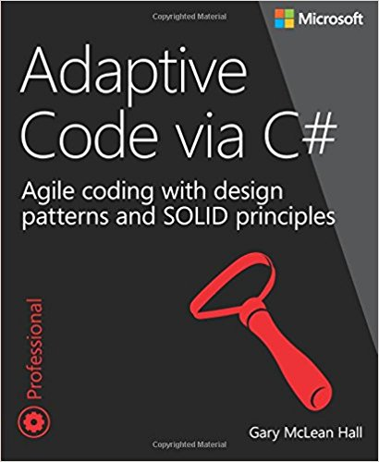
SOLID in this course
We will take a look at all five SOLID principles, BUT with some extra emphasis on:
Dependency Injection
Liskov Substitution
Mostly based on material from this sort-of-canonical book

Slide 34
What is a Design Pattern?

Slide 35
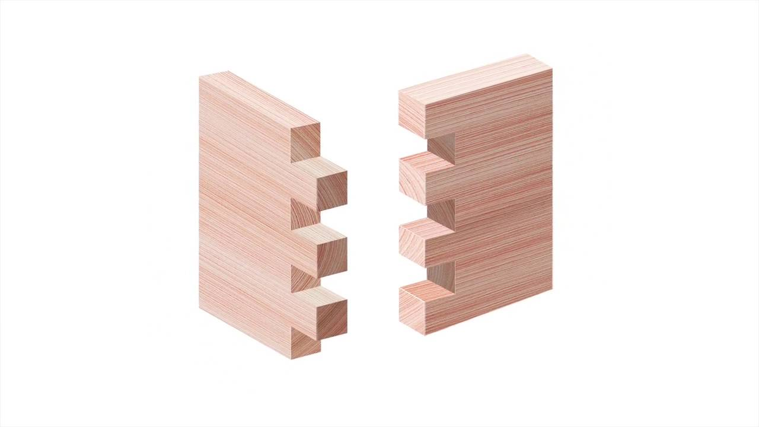

Slide 36
What is a Design Pattern?
From Wikipedia:
A general, reusable solution to a commonly occurring problem within a given context in Software Design.
It is not a finished design that can be transformed directly into code.
It is a description or template for how to solve a problem that can be used in many different situations. Design patterns are formalized best practices that the programmer can use to solve common problems when designing an application or system.

Slide 37
What is a Design Pattern?
But also:
A “language” by which we can talk about design
A shared definition of structures in design/code
Structures help us manage complexity!

Slide 38
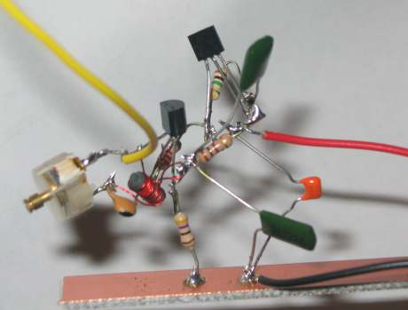

Slide 39
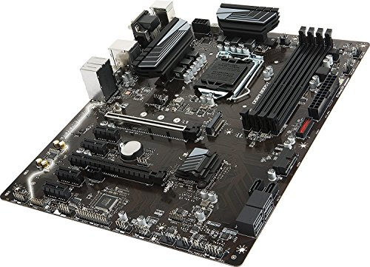

Slide 40
Design Patterns = Distilled Experience

Slide 41
Design Pattern scale – Code Idioms
Short snippets of code for very common problems
Example: Print out all items in a List<T>:
foreach (T item in items)
{
Console.WriteLine(item);
}

Slide 42
Design Pattern scale – Class relations
The classic level for Design Patterns; solves a common problem by defining a few (< 10) classes.
We (should) know some already:
Singleton
Factory Method / Abstract Factory
Adapter
Proxy
Template Method
Command

Slide 43
Design Pattern scale – Class relations
Creational
Singleton
Factory Method
Abstract Factory
Structural
Adapter
Proxy
Behavioral
Template Method
Command

Slide 44
Design Pattern scale – Architecture
More complex than previous level – encompasses structure of entire application
Examples:
Data Warehouse
MVC/MVVM
Microservices
Machine Learning

Slide 45

Design Patterns in this course
Typically at the Class Relations level
We will take a look at some slightly more complex Design Patterns from the canonical Design Patterns book
Also look at a couple of patterns not (explicitly) mentioned in this book
Not necessarily use material from the book…

Slide 46
Design Patterns in two words…

Slide 47
Isolate variation!

Slide 48
What is Refactoring?

Slide 49
2ab + 14b + 5ab

Slide 50
2ab + 14b + 5ab

Slide 51
7ab + 14b

Slide 52
7b(a) + 7b(2)

Slide 53
7b(a+2)

Slide 54
What is Refactoring?
Usually a two-step dance:
Identify design/code that needs refactoring (code smells…)
Perform the refactoring
Often supported by tests:
Perform a refactoring operation
Run the test
If test OK, proceed to next refactoring
If test fails, roll back refactoring and reconsider…

Slide 55
What is Refactoring?
Code smells (a.k.a. Anti-Patterns)…
Duplicated Code
Shotgun Surgery
Large class (or God class)
Inappropriate Intimacy
Feature Envy
Comments
…

Slide 56
What is Refactoring?
Refactoring operations…
Rename Method
Extract Method
Replace Temp with Query
Decompose Conditional
Replace Type Code with Strategy/State
Replace constructor with Factory Method
…

Slide 57
When to Refactor?
Example: Test-Driven Development (TDD)
The Red-Green-Refactor principle
Write a unit test for the code you are about to write
Run the unit test; it will (obviously) fail [RED]
Write the code itself, until the unit test passes [GREEN]
Perform refactorings on your code [REFACTOR]
BUT you can always refactor, even in more traditional development processes!

Slide 58

Refactoring in this course
Look at selected Code Smells and Refactoring Operations from the canonical Refactoring book
Not necessarily use material from the book…
Maybe try it out on our own legacy code…?

Slide 59

Refactoring in this course
Maybe we will also look at some specific refactor-towards-patterns examples…

Slide 60
What about C#?

Slide 61
Didn’t we do C# on 1. + 2.semester…?
Have you heard about
Iterators and Indexers
Operator Overloading
Extension Methods
Reflection
Anonymous Types
Tuples and Local Methods
…?

Slide 62
Didn’t we do C# on 1. + 2.semester…?
Have you used LINQ for
Data Transformation
Value aggregation (beyond Sum()…)
Set-related operations
Parallel query execution
…?

Slide 63
Didn’t we do C# on 1. + 2.semester…?
Also quite important (in my opinion) to know about more sophisticated language elements
In order to choose the right tools for the job, you need to know what’s in the toolbox ☺.

Slide 64
The Big Picture
SOLID: Giving us general, best-practice principles to strive towards when designing/constructing software.
Design Patterns: Giving us more focused solutions for how to implement a certain aspect of our software.
Refactoring: Giving us techniques to recognise low-quality design/code, and to improve the quality in a systematic way. The resulting code will often converge towards the SOLID principles and Design Patterns.
Advanced C#: Giving us an extended C#-toolbox for implementing the designs/code we have created.

Slide 65
Course overview (tentative…)
Week | Topic
5 | Intro, brush-up, warm-up
6 + 7 | Advanced OO-programming with C#
8 + 9
11 | The SOLID principles
12 + 13 | Selected Design Patterns
14 + 15 | Refactoring
16 | Easter Holiday
17 | Work on Mandatory Project
18 - 22 | Work on Synopsis
25 | Exam (18+19+20+21/6)

Slide 66
A typical day in ASWC (before Easter)
Before lunch: Short ”lectures” by me, you do small-to-medium-sized exercises, we discuss solutions.
After lunch: I present a larger exercise, you work on said larger exercise, we discuss solutions.
NB: Typical, but maybe not always…
After Easter: Mandatory assignment / Synopsis

Slide 67
Rules of Engagement (for exercises)
I prefer – but do not insist – that you work in pairs.
Two: best, one: OK, three: naahhh…
Sit where you like (classroom, group rooms, …)
No policing; you’re here to learn, right…?
BUT: classroom itself is ”business-only”
In the classroom we work on exercises
If you’re not working: keep it quiet
Take a break when you need a break.

Slide 68


